Slide 1
IT-331 ( Computer Graphics 1)
Lecture 8
Three Dimensional Geometric Transformations
Dr. Mohammed El-Said
Assistant Professor, Computer Science Dept.,
Faculty of Computers & Artificial Intelligence,
Helwan University - Cairo, Egypt.

Slide 2
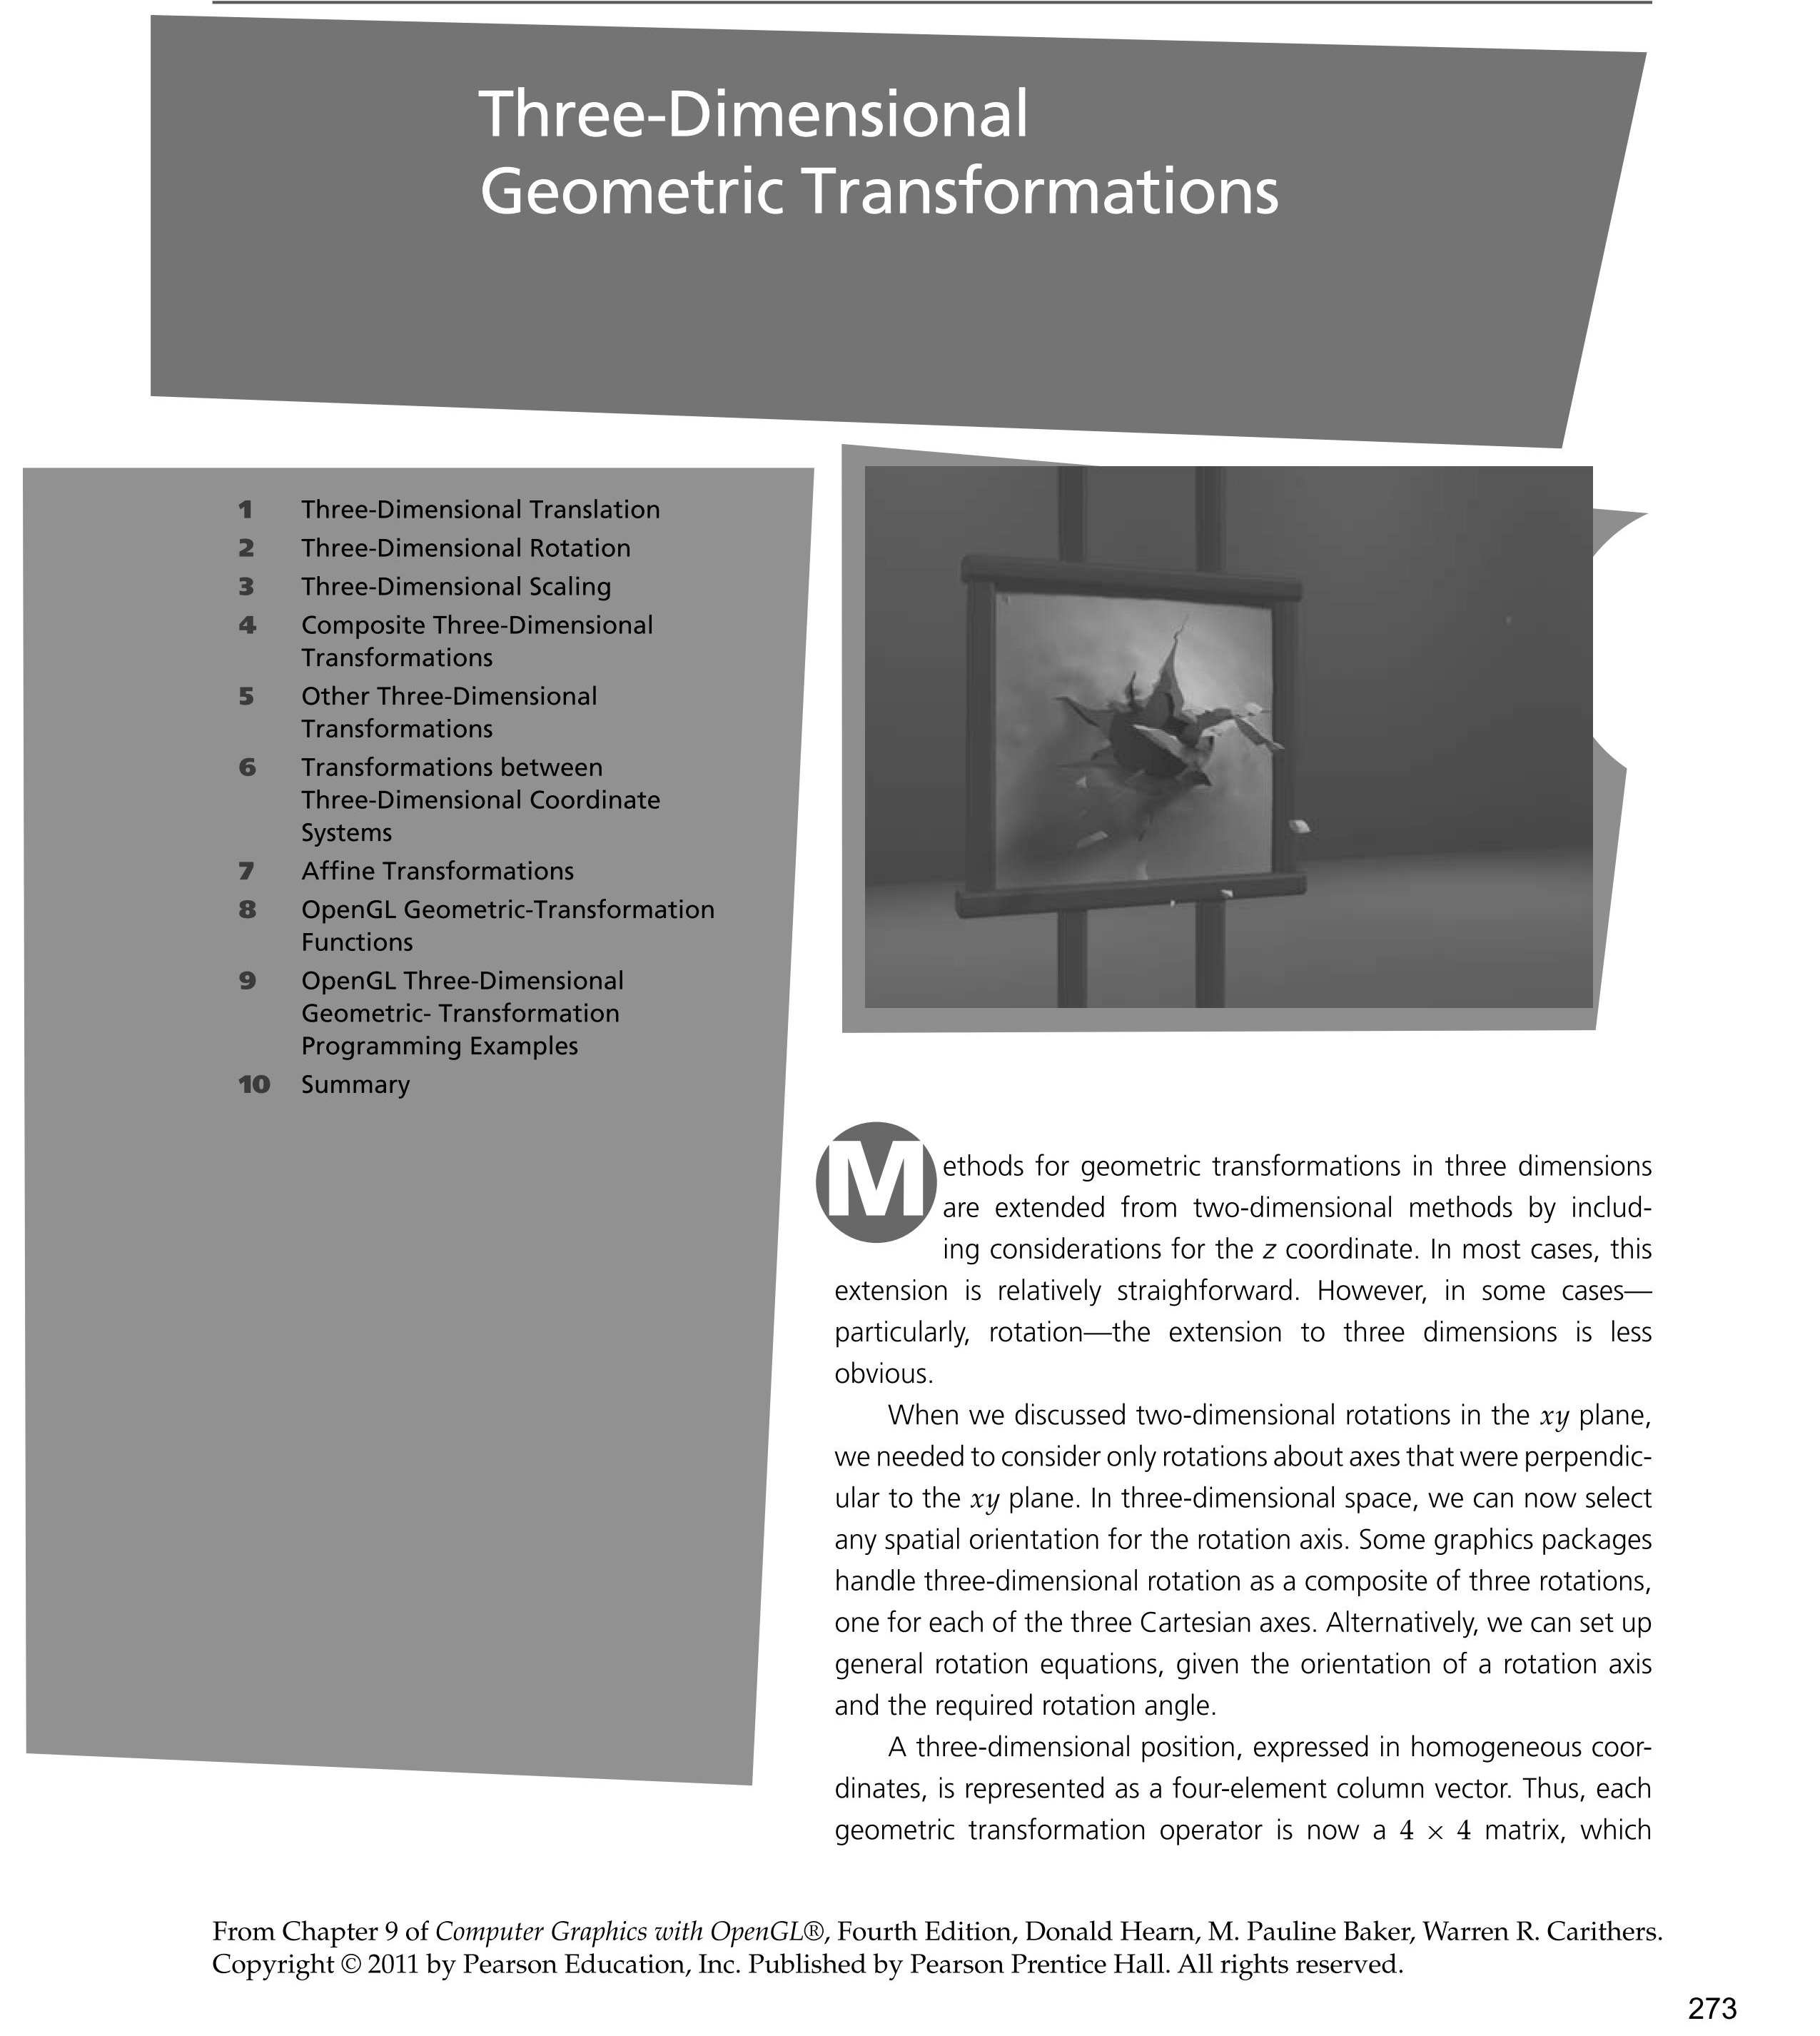

Slide 3
3D Transformations.
Use homogeneous coordinates, just as in 2D case.
Transformations are now 4x4 matrices.
We will use a right-handed (world) coordinate system - ( z out of page ).
y
Note:
Convenient to think of display as
Being left-handed !!
( z into the screen )
x
z (out of page)

Slide 4
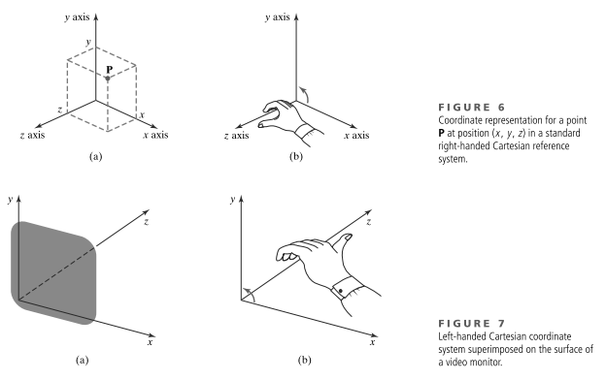

Slide 5
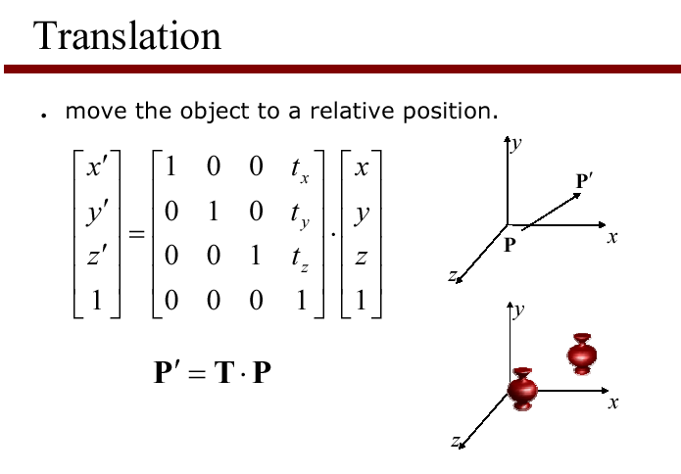
Simple extension to the 3D case:

Slide 6
Scale in 3D.
Simple extension to the 3D case:

Slide 7
Rotation in 3D
Need to specify which axis the rotation is about.
z-axis rotation is the same as the 2D case.

Slide 8
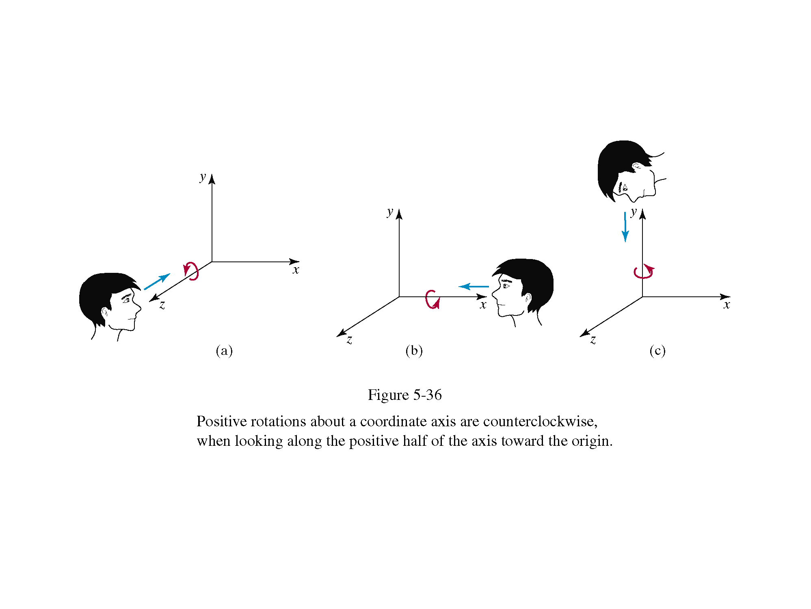

Slide 9
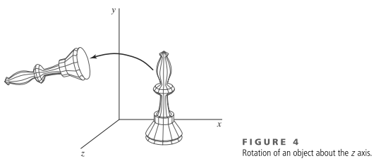
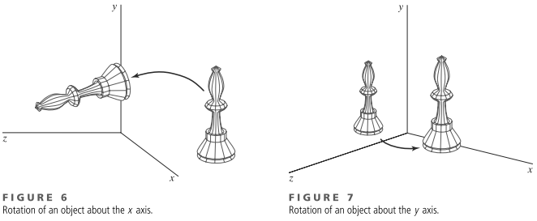

Slide 10
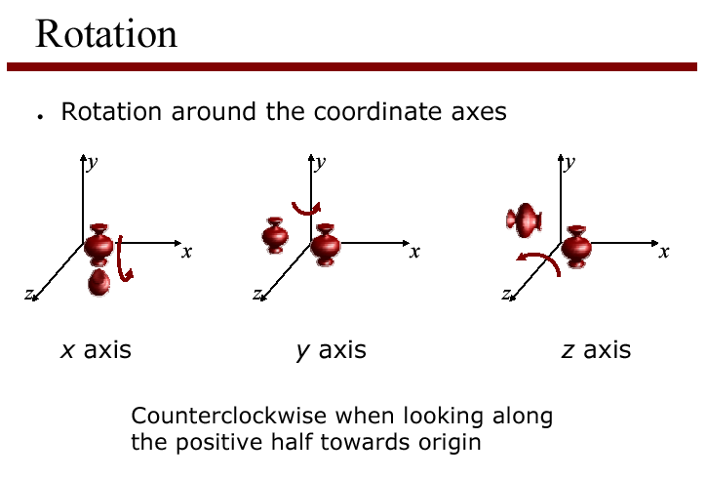

Slide 11
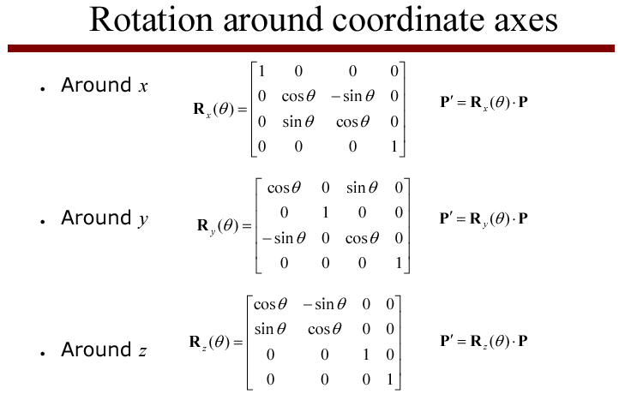

Slide 12
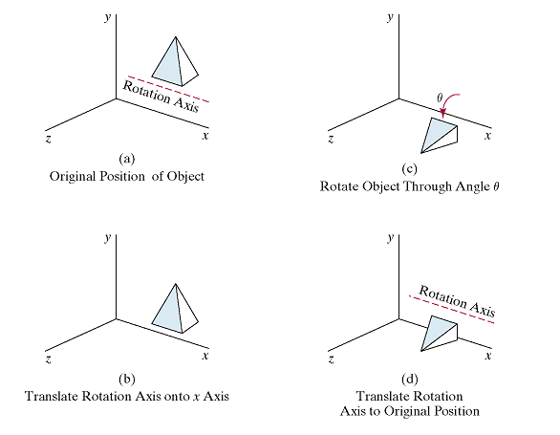
Rotation around an axis parallel to x-axis

Slide 13
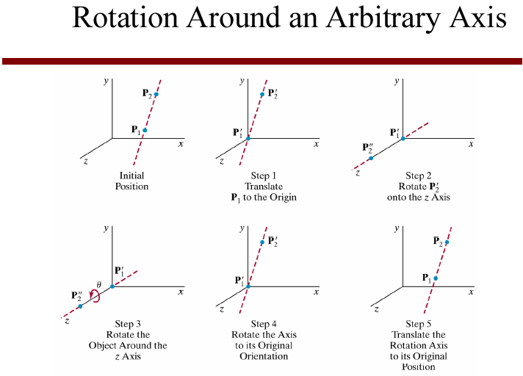

Slide 14
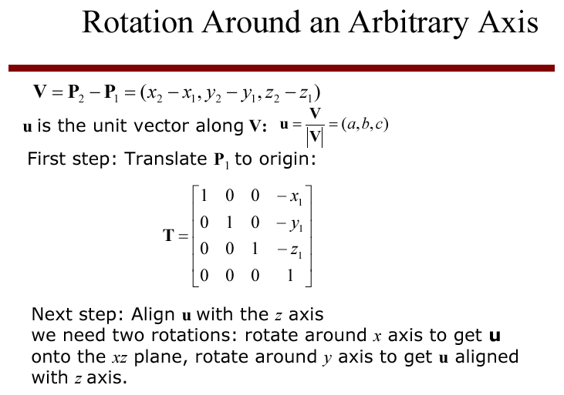

Slide 15
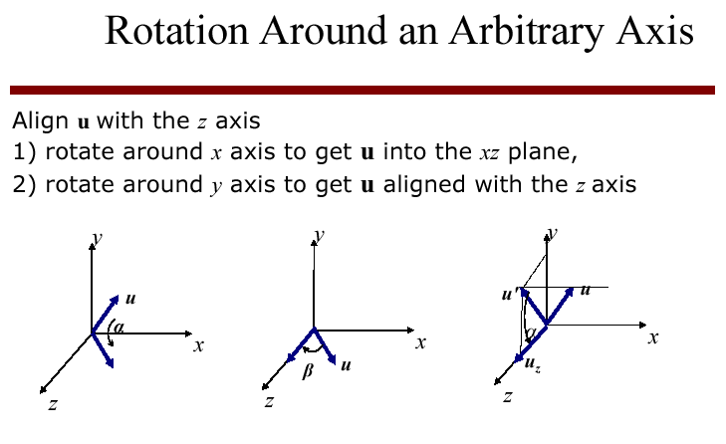

Slide 16
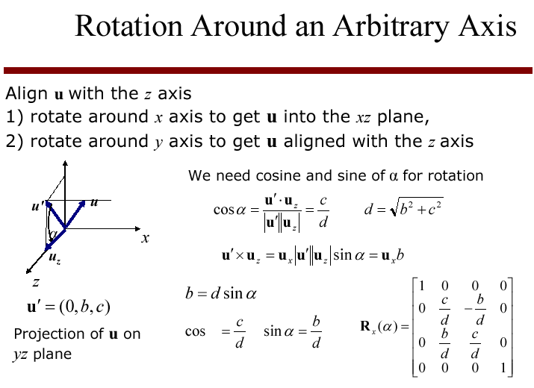
α

Slide 17
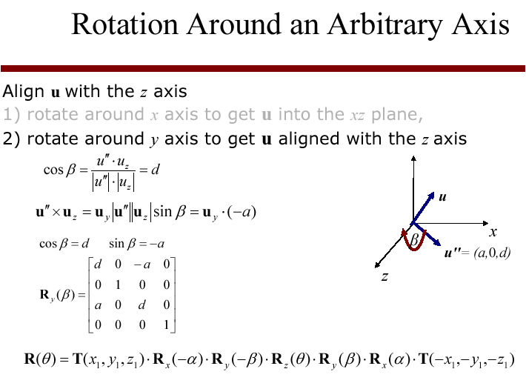

Slide 18
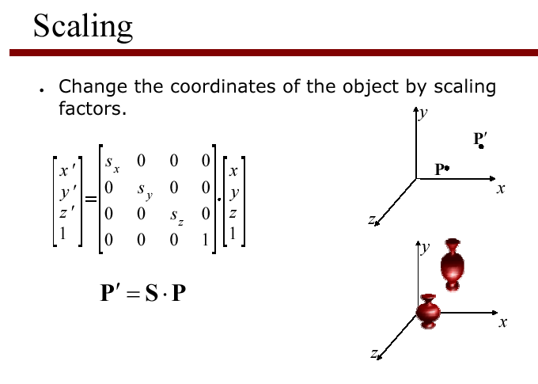
Scaling an object with this transformation will also move its position relative to the origin - so move it to the origin, scale it, then move it back...

Slide 19
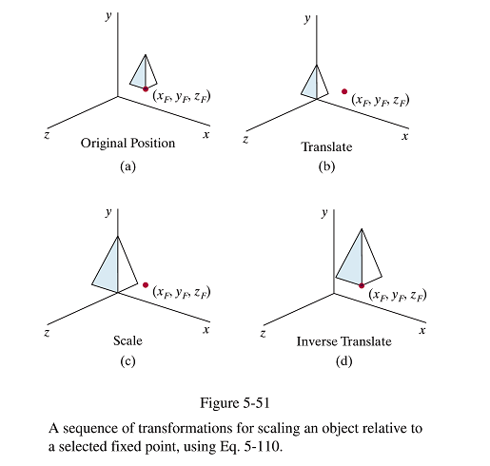

Slide 20
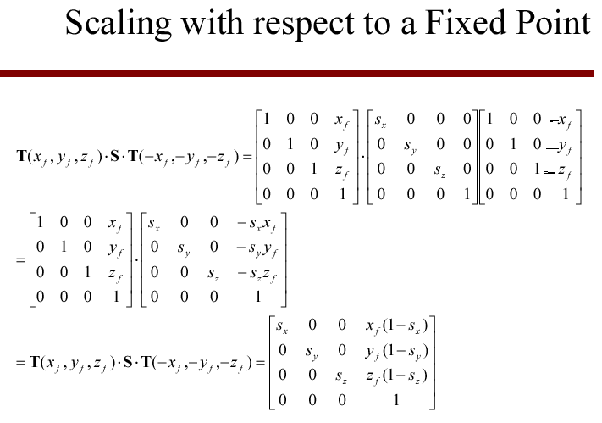

Slide 21
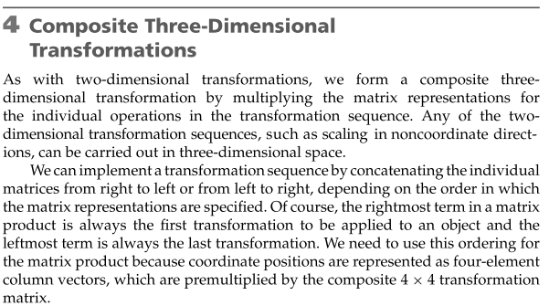

Slide 22
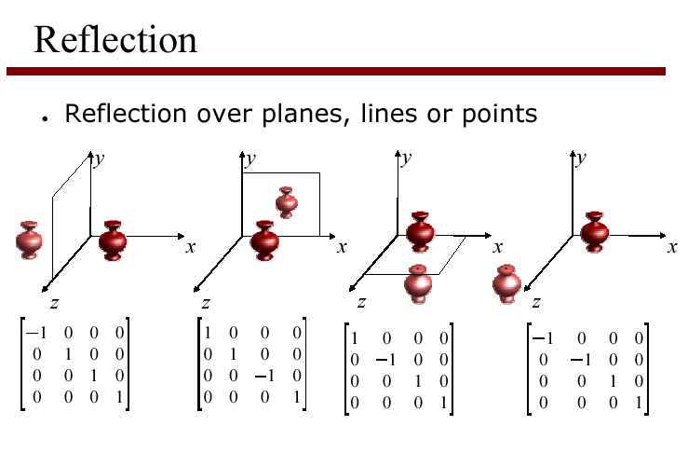

Slide 23
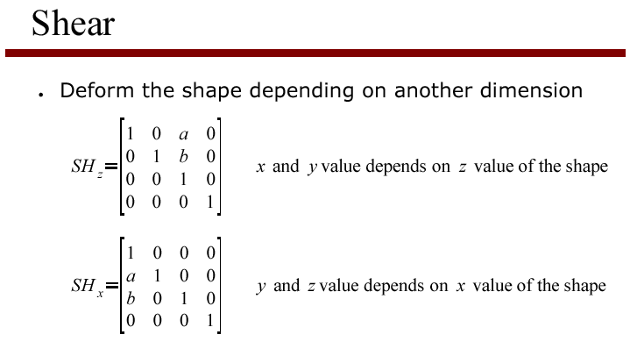

Slide 24
